Slide 1
Amazon Sales Data Analysis Using Power BI
An in-depth analysis of sales performance for a specified duration, Overview Metrics, Sales Breakdown, Profit Analysis, Regional Sales Analysis.

Slide 2

Project Objective
The aim of this project is to assess Amazon's sales performance for a specified duration based on interactive visualizations. By examining essential metrics, and draw conclusions that will inform improved future sales plans and enhanced business decision-making.

Slide 3
Data Cleaning
(Power Query Editor): Power Query Editor was utilized to clean the dataset such as making the first-row headers for the People and Returns tables, adding a new column for Delivery Date and pulling Year values for trend analysis.

Slide 4
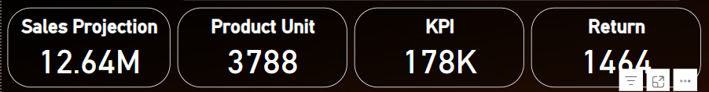
Data Analysis
➡️ Overview Metrics:
These performance metrics give the general picture of the sales performance, including projected revenue, quantity of product units sold, key performance indicators, and number of product returns.

Slide 5
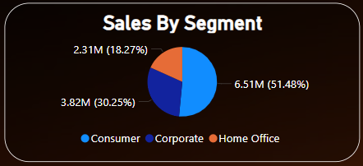
Data Analysis
➡️ Sales Breakdown:
Sales by Segment: Consumer earns the maximum revenue, followed by Corporate and Home Office.

Slide 6
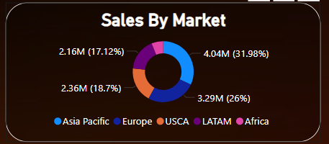
Data Analysis
➡️ Sales Breakdown:
Sales by Market (Region-Wise): US & Canada (USCA) is the biggest sales region, followed by LATAM and Europe.

Slide 7
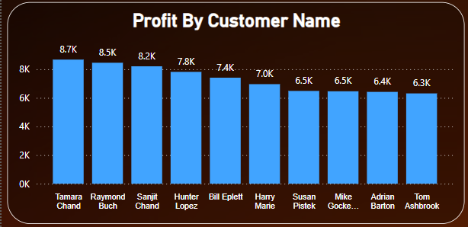
Data Analysis
➡️ Profit Analysis:
Profit by Customer Name (Top 10 Customers): Tamara Chand provides the highest profit, followed by Raymond Buch and Sanjit Chand.

Slide 8
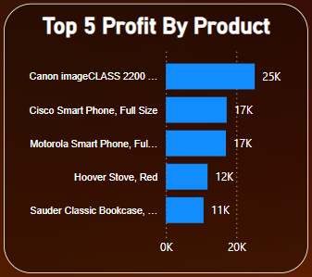
Data Analysis
➡️ Profit Analysis:
Top 5 Most Profitable Products: Canon image CLASS 2200 is the most profitable product, with a contribution of 25K in profit.

Slide 9
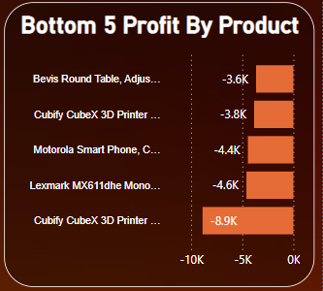
Data Analysis
➡️ Profit Analysis:
Bottom 5 Least Profitable Products: Cubify CubeX 3D Printer is the least profitable product, which generates -8.9K in losses.

Slide 10
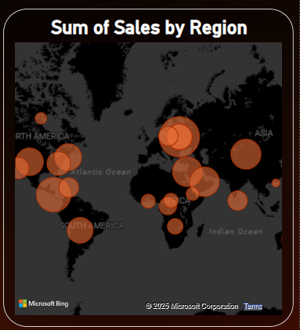
Data Analysis
➡️ Regional Sales Analysis:
The Sum of Sales by Region is visualized through a map.
Larger circles represent greater sales concentrations.
The largest sales hubs seem to be located in North America, Europe, and some areas of Asia.

Slide 11
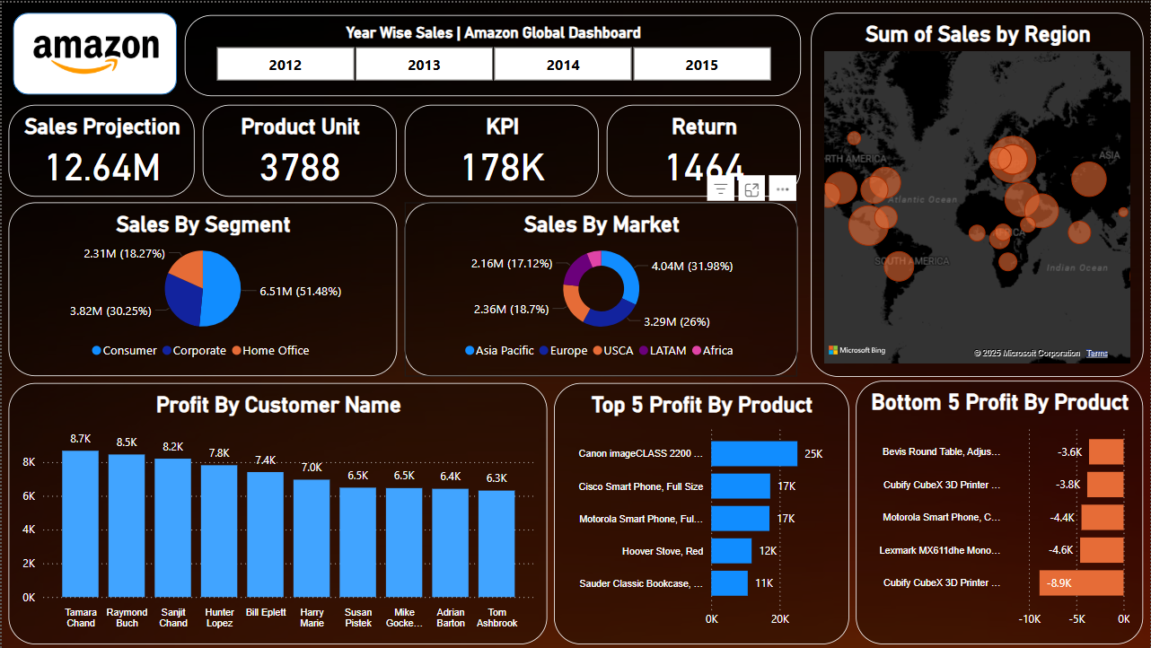
Data Visualization
Microsoft Power BI was utilized to design informative bar charts, pie charts, donut charts, and maps.

Slide 12
Recommendation
Intensify Emphasis on the Consumer Segment for Increased Revenue Generation: As 51.48% of sales are generated from consumers, targeted marketing campaigns and promotions for them could generate even more revenue.
Increase Market Share in Underperforming Regions: Asia Pacific and Africa have lower percentages of sales. Marketing and logistics investments in these markets may increase sales.
Increase Product Profitability: The Cubify CubeX 3D Printer has the largest loss. Analysis of pricing, cost of suppliers, or dropping low-selling products may be worthwhile.
Leverage High-Profit Products: Canon image CLASS 2200 and Cisco Smart Phone, Full Size are the most profitable. Increasing inventory, promotions, and advertising of these items can increase profits even more.
Track High Returns: Return count is 1,464. Examining return reasons (defective goods, wrong shipments, etc.) can save costs and enhance customer satisfaction.

Slide 13
Conclusion
This Power BI dashboard provides actionable insights into Amazon's sales performance, profitability, and regional trends. Using these data-driven recommendations, Amazon can improve sales strategies, optimize resource allocation, and maximize profitability.

